Slide 1

Fraud DETECTION BY USING DEEPCHECKS LIBRARY
GROUP 7

Slide 2
Credit Fraud | Dealing with Imbalanced Datasets
Python · Credit Card Fraud Detection

Slide 3

Fraud
According to The Financial Cost of Fraud Report fraud costs businesses and individuals around the world more than US$5 trillion every year. And while fraudulent transactions represent only a small percentage of any organization’s revenue, they can still run into the millions of dollars and carry regulatory implications. Over the last decade, more and more organizations are moving from manually written, rule-based systems to AI fraud detection systems that utilize machine learning.

Slide 4

How Can Help
Deepchecks can be used to ensure the end-to-end quality of your ML pipeline, as well as enable us to deal with new patterns of fraudulent behaviour. Deepchecks connects to the different components of our training and production pipelines (raw features, processed features, predictions, labels), and learns their behaviour over time. It then enables us to:
Detect in real-time concept drift, out of distribution samples, anomalies, and data integrity issues
Define a rule-based model to distinguish whether input and output data is legitimate or not, with the system triggering alerts and displaying insights.

Slide 5
Introduction
In this kernel we will use various predictive models to see how accurate they are in detecting whether a transaction is a normal payment or a fraud. As described in the dataset, the features are scaled and the names of the features are not shown due to privacy reasons. Nevertheless, we can still analyse some important aspects of the dataset.

Slide 6
Our Goals:
Understand the little distribution of the "little" data that was provided to us.
Create a 50/50 sub-dataframe ratio of "Fraud" and "Non-Fraud" transactions. (NearMiss Algorithm)
Determine the Classifiers we are going to use and decide which one has a higher accuracy.
Create a Neural Network and compare the accuracy to our best classifier.
Understand common mistakes made with imbalanced datasets.

Slide 7
Correcting Previous Mistakes from Imbalanced Datasets:
Never test on the oversampled or undersampled dataset.
If we want to implement cross validation, remember to oversample or under sample your training data during cross-validation, not before!
Don't use accuracy score as a metric with imbalanced datasets (will be usually high and misleading), instead use f1-score, precision/recall score or confusion matrix
References:
Hands on Machine Learning with Scikit-Learn & TensorFlow by Aurélien Géron (O'Reilly). CopyRight 2017 Aurélien Géron
Machine Learning - Over-& Undersampling - Python/ Scikit/ Scikit-Imblearn by Coding-Maniac auprc, 5-fold c-v, and resampling methods by Jeremy Lane (Kaggle Notebook)

Slide 8
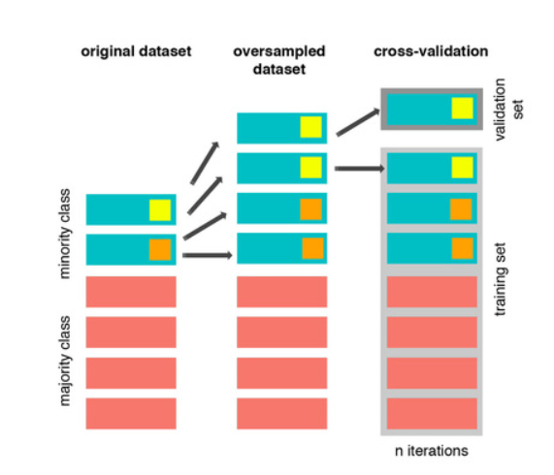
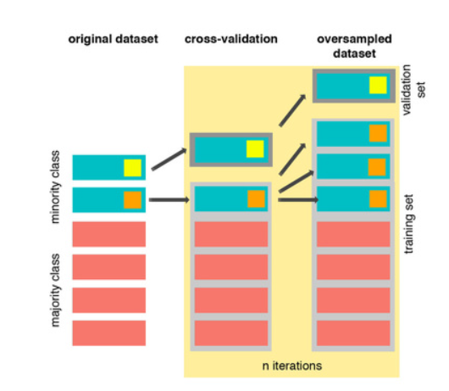
To avoid overfitting: we do undersample / oversample the data after cross validating !
The Wrong Way:
The Right Way:
References:
Dealing with imbalanced data: undersampling, oversampling and proper cross-validation smote explained for noobs
Machine Learning - Over-& Undersampling - Python/ Scikit/ Scikit-Imblearn

Slide 9
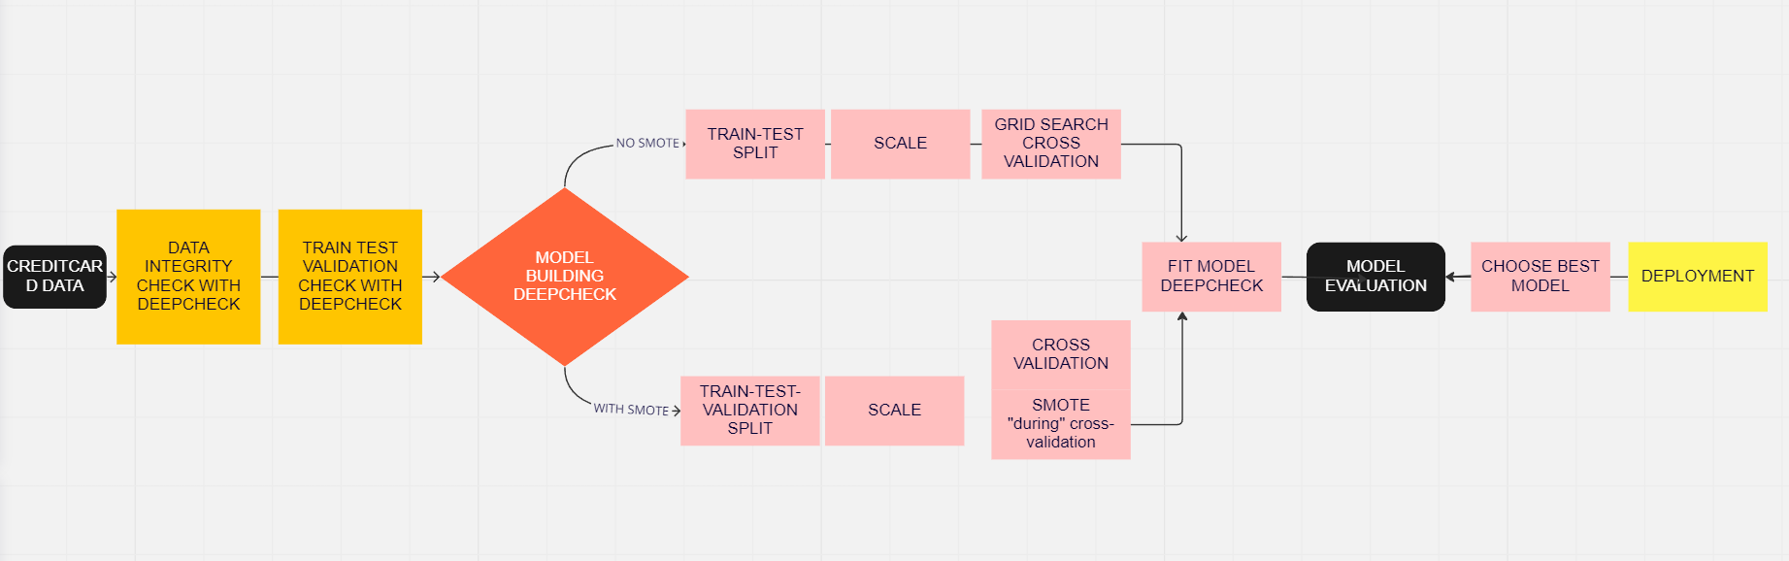
FLOW CHART FOR ML MODELS

Slide 10
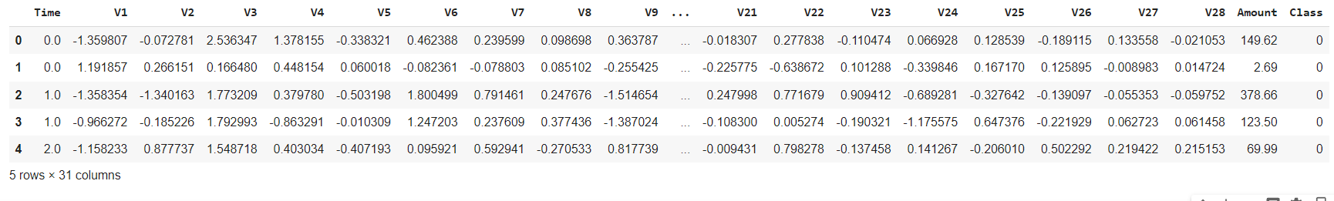
Understanding our data
The first thing we must do is gather a basic sense of our data. Remember, except for the transaction and amount we don’t know what the other columns are (due to privacy reasons).
The only thing we know, is that those columns that are unknown have been scaled already.
Normal transaction: 284315
Fraudaient transaction: 492
Our Features:

Slide 11
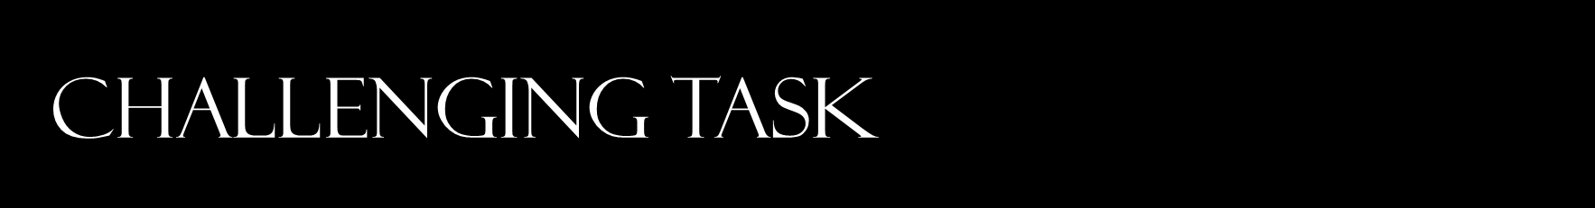
Supervised Learning
A supervised model is used for the training process, the accuracy of which is only as good as the training dataset it has seen. It might be a challenging task to implement this method with great accuracy as we are most likely to encounter class imbalanced.

Slide 12
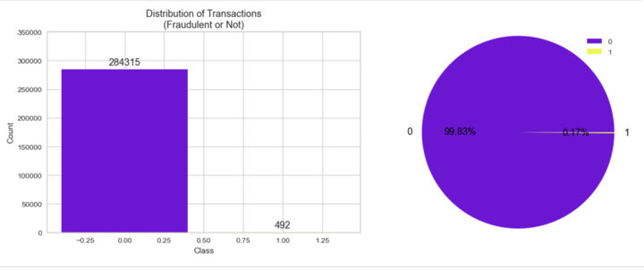
We have imbalanced classes

Slide 13
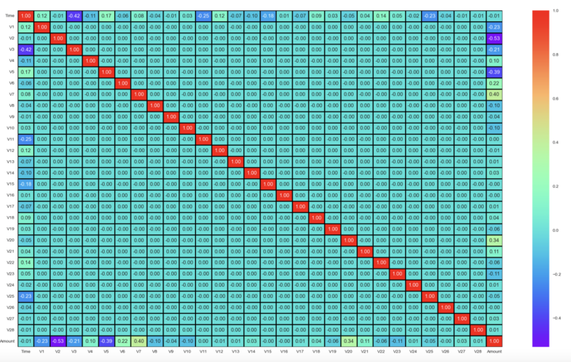
We check the multicollinearty
Negative Correlations: V17, V14, V12 and V10 are negatively correlated. Notice how the lower these values are, the more likely the end result will be a fraud transaction.
Positive Correlations: V2, V4, V11, and V19 are positively correlated. Notice how the higher these values are, the more likely the end result will be a fraud transaction.

Slide 14
Classifiers (UnderSampling):
We will train three types of classifiers Logistic Regression, Random Forest, XGBoost and Neural Network to decide which classifier will be more effective in detecting fraud transactions. Before, we have to split our data into training and testing sets and separate the features from the labels.

Slide 15
WE PREFER TO CHECK PRECISION / RECALL
True Positives: Correctly Classified Fraud Transactions
False Positives: Incorrectly Classified Fraud Transactions
True Negative: Correctly Classified Non-Fraud Transactions
False Negative: Incorrectly Classified Non-Fraud Transactions
Precision: True Positives/(True Positives + False Positives)
Recall: True Positives/(True Positives + False Negatives)
Precision as the name says, says how precise (how sure) is our model in detecting fraud transactions while recall is the amount of fraud cases our model is able to detect.
Precision/Recall Tradeoff: The more precise (selective) our model is, the less cases it will detect. Example: Assuming that our model has a precision of 95%, Let's say there are only 5 fraud cases in which the model is 95% precise or more that these are fraud cases. Then let's say there are 5 more cases that our model considers 90% to be a fraud case, if we lower the precision there are more cases that our model will be able to detect.

Slide 16
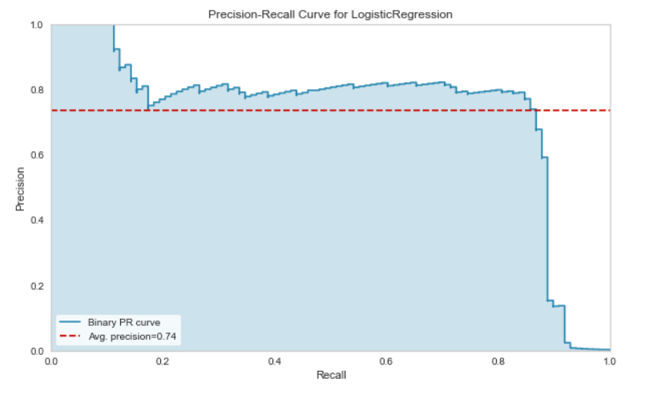
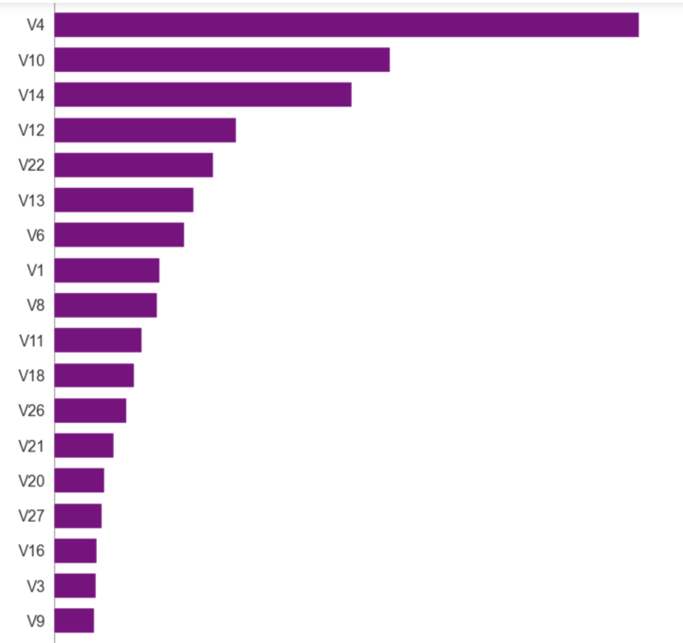
LOGISTIC REGRESSION MODEL
Precision Recall Curve (log_pipe_model_shap)
BEST FEATURES

Slide 17
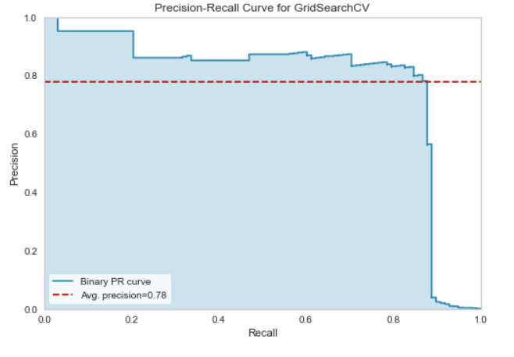
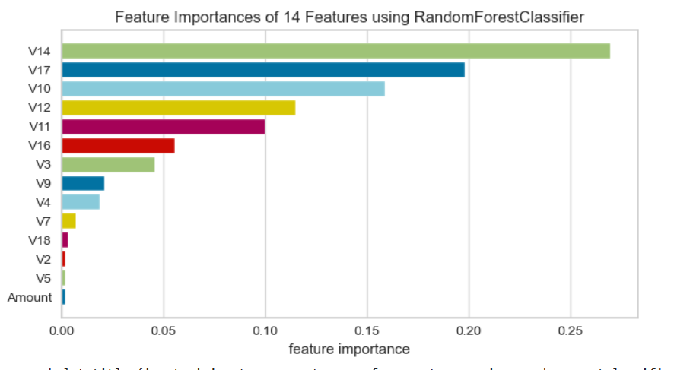
RANDOM FOREST MODEL
PRECISION / RECALL CURVE
BEST FEATURES

Slide 18
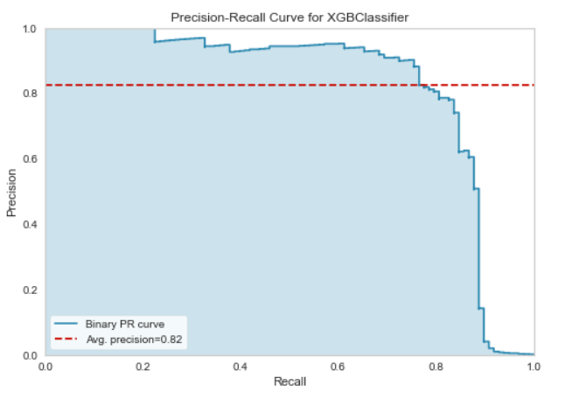
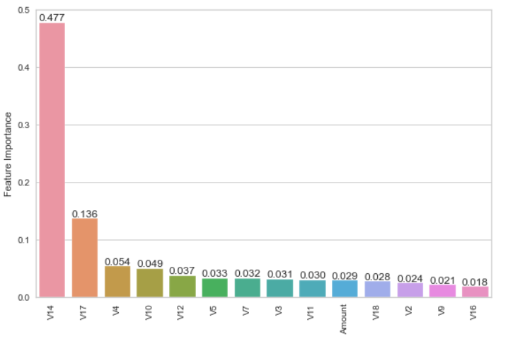
XGBoost Classifier
PRECISION / RECALL CURVE
BEST FEATURES

Slide 19
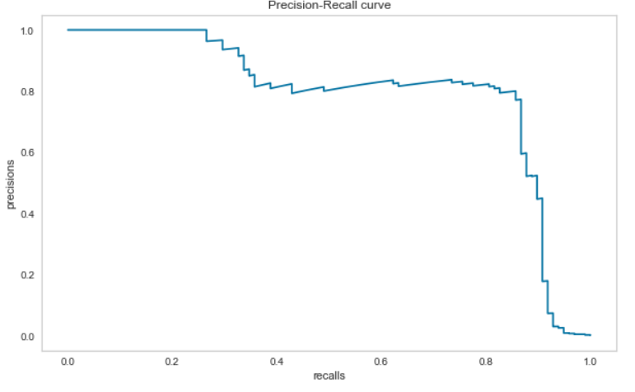
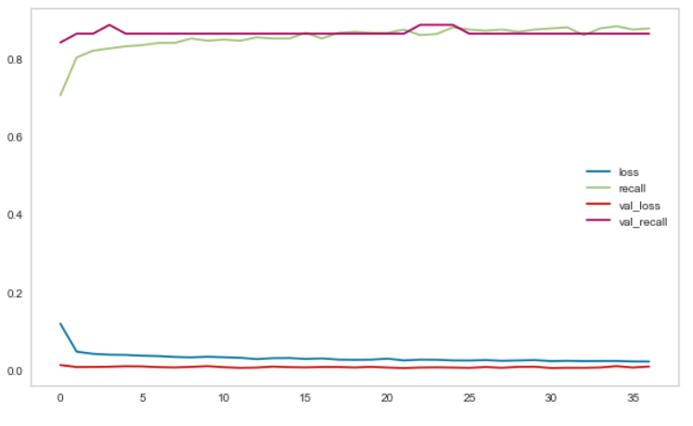
NEURAL NETWORK
PRECISION / RECALL CURVE
LOSS PLOT

Slide 20
Conclusion:
Our best model is : with the recall score :

Slide 21
THANK YOU!

